Slide 1
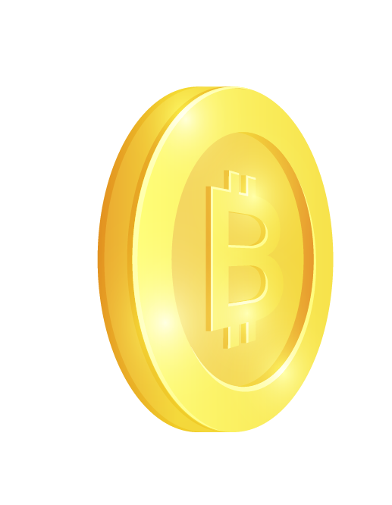
Bitcoin Trading Which networks are trustworthy?
Trevor Allison, Cate Dombrowski, Amey Ghate, Sankalp Kulkarni, Rathil Madihalli

Slide 2
Table of contents
01
02
03
04
05
06
Introduction
Our Dataset
Goodness and Fairness
Fraud Analysis
Time Trends
Conclusion

Slide 3
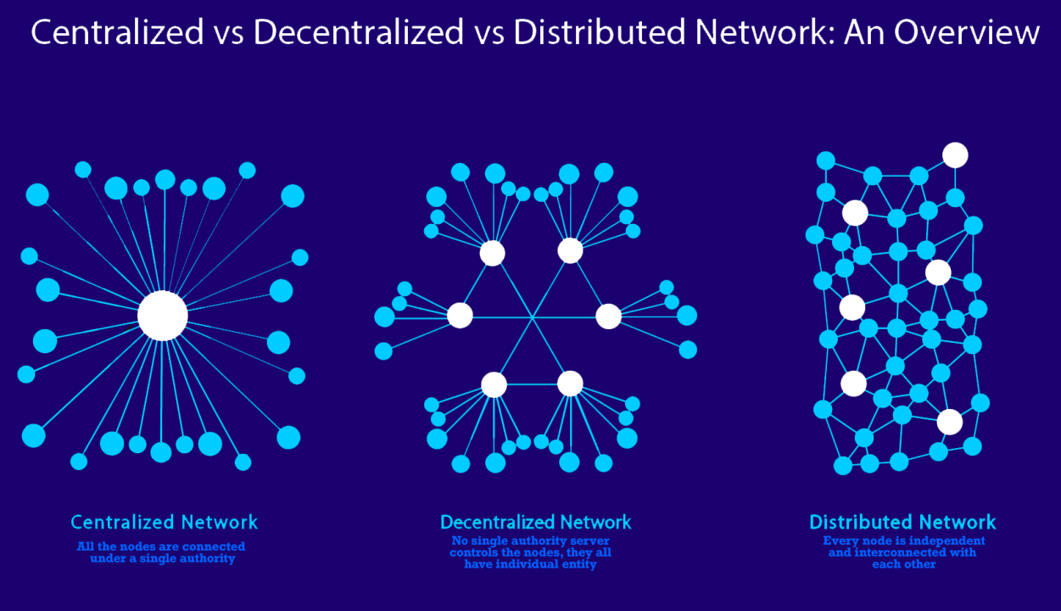
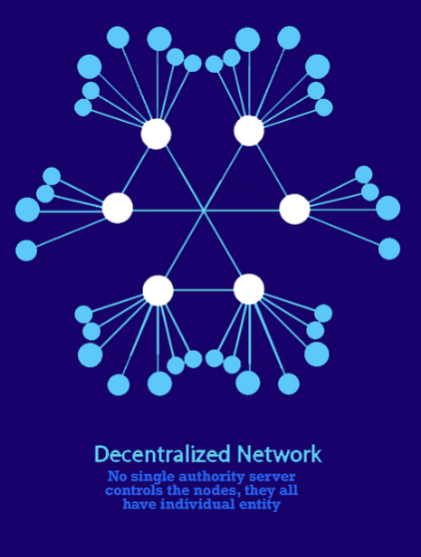
Centralized
Decentralized
Notes:
Traditional Finance takes a centralized structure, where the federal government controls the center node, representing a bank or credit union, and each edge node is a person acting in accordance to their bank. Blockchain technology introduces decentralized finance, where nodes are organized in a distributed system. Each node interacts with one another without a central authority to govern transactions
Benefits of Decentralized: 50% of the nodes can go down and the system will still function, attack resistant, collusion resistant- it is of better benefit to the miners to have a trusted network with proof of work rather than try to take over power so everyone has incentive to cooperate

Slide 4

Understanding Trust within the Blockchain
Market Integrity
Blockchain relies on trusted networks
Fraud Detection
Investment and Trading Strategies
Informed decision making
Market analysis
Strategic networking
Regulatory Compliance
Risk Management
Privacy and Securing
Notes:
Potential Business Implications:
Market Integrity and Trust
Enhanced Trust
Fraud Detection
Investment and Trading Strategies
Informed decision making
Risk Management
Regulatory Compliance and Monitoring
Useful as a compliance tool
Useful for market analysis
Network Analysis and Optimization
Strategic networking
Optimization of transaction flows
Data Privacy and Security Concerns
Basic Privacy Issues
Security Risks

Slide 5
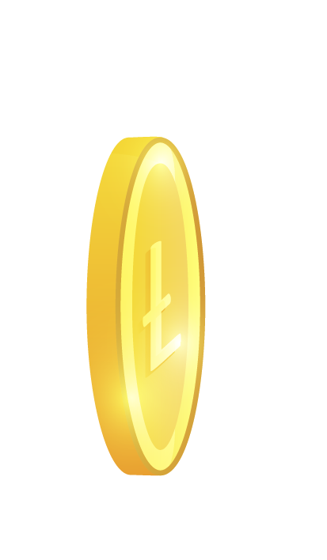
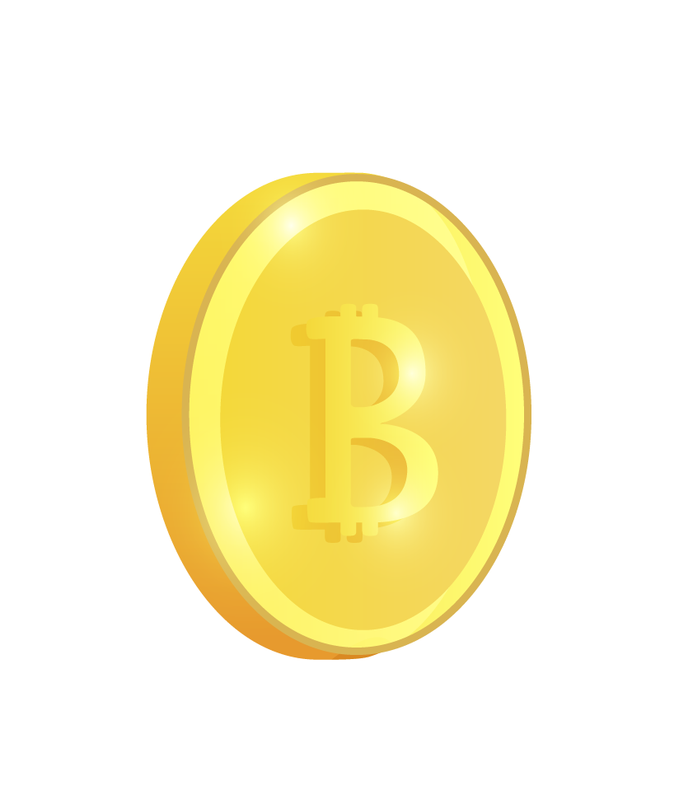
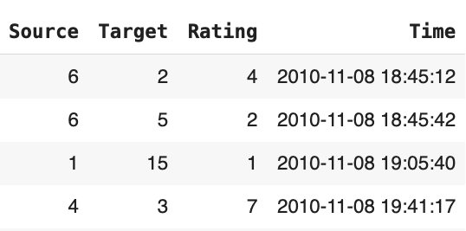
Our Dataset
People trading on the Bitcoin OTC platform, web of trust network:
5,881 Nodes
35,592 Edges
Data from Nov 2010 to Jan 2016
Notes:
S. Kumar, F. Spezzano, V.S. Subrahmanian, C. Faloutsos. Edge Weight Prediction in Weighted Signed Networks. IEEE International Conference on Data Mining (ICDM), 2016.
Count of nodes that are only targets: 1067
Count of nodes that are only source: 23

Slide 6
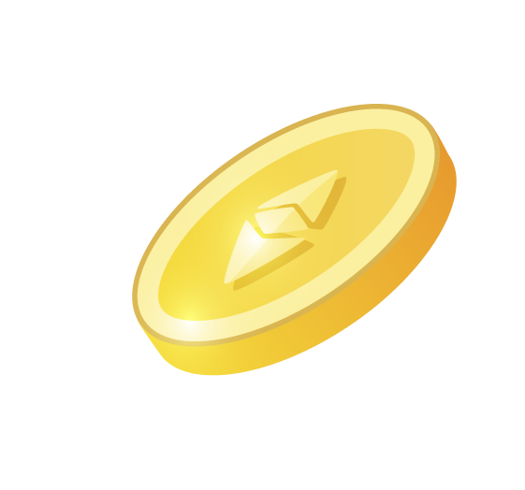
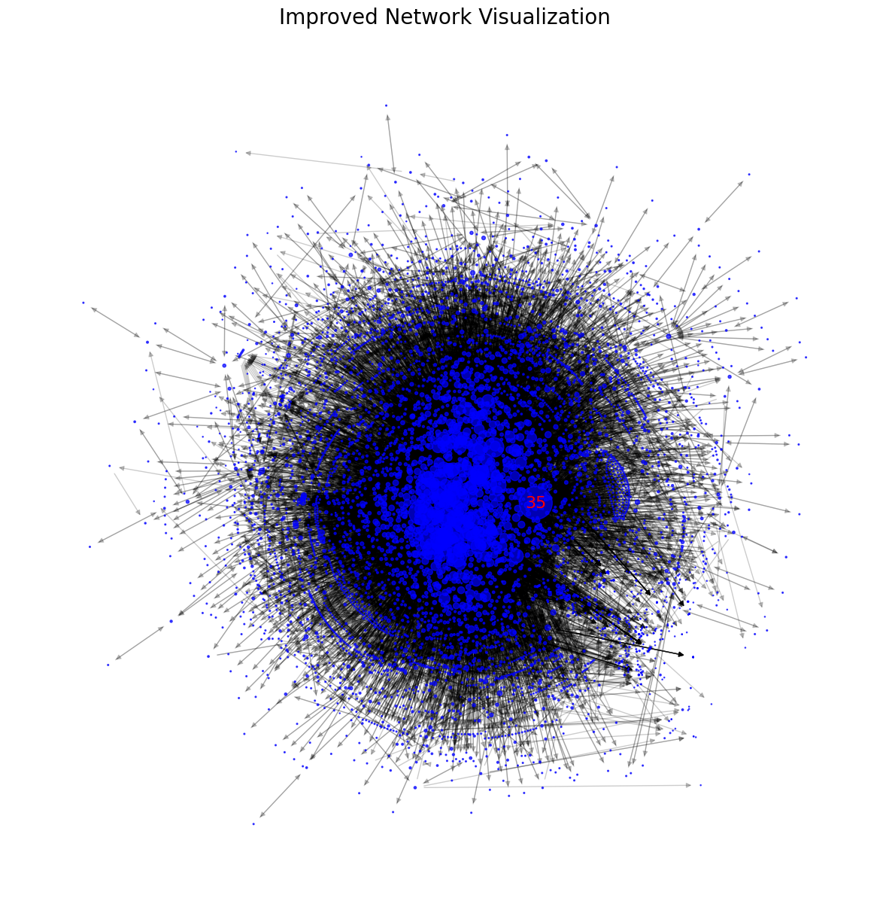
Network Visualization
Notes:
We took a look at the nodes with high negative and high positive ratings to look deeper into the communities surrounding the extreme nodes

Slide 7
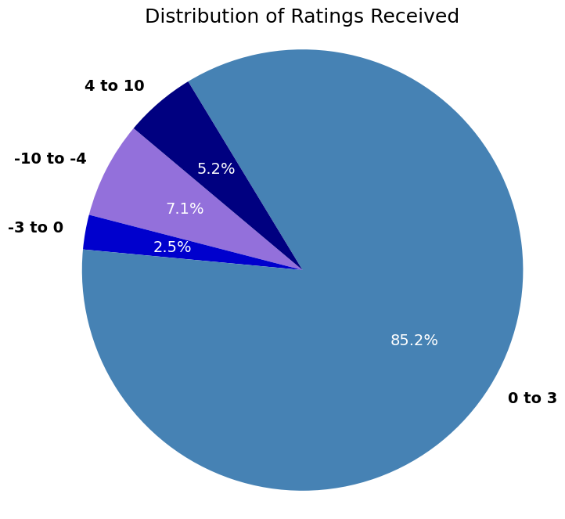
Exploratory Data Analysis
In each group, the most common rating given out is 1
Notes:
Mode is 1 for all four categories
Nodes with 10 rating are mostly a target, not rating other nodes

Slide 8
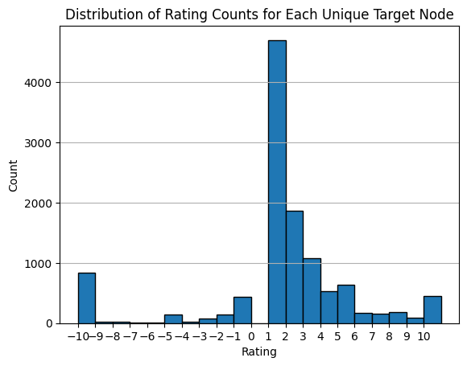
Distribution of Ratings : Entire Network
Notes:
Average ratings

Slide 9
Goodness and Fairness
Goodness
Fairness
Measures the trustworthiness of each node
Measures how accurate of a rater the node is

Slide 10
Results
Goodness
Fairness
Node | Score
3665 | 1.0
4182 | 1.0
4737 | 0.83009
3786 | 0.82573
3787 | 0.82573
Node | Score
4655 | 0.17283
4433 | 0.15098
4737 | 0.14832
3786 | 0.14077
3787 | 0.13189
Notes:
-assigns each node with a score between -1 and 1
-scores are updated by their neighbors as each node is dependent on each other
fairness is initialized to 1 for each node, assuming that all nodes are fair in the beginning
Since initially there are no incoming edges, goodness is initialized to 0
Fairness score update: how the nodes outgoing edge weights compare to the goodness of the target nodes. The target has a baseline quality score, then we assign fairness based on comparing the baseline to the score the rater gave
juxtaposes the ratings given by a node against the current goodness scores of the rated nodes by averaging the discrepancies. A smaller discrepancy means a higher fairness score, indicating that the node rates others in a way that aligns closely with the general consensus.
Goodness score update: calculates a new goodness score based on the fairness of the nodes providing incoming edges
weighted average of the incoming ratings, where the weights are the fairness scores of the raters. This means that ratings from fairer nodes have a greater impact on a node's goodness score
Top 5 Scores:
Goodness- score of one means that the node is commonly rated highly by others
Fairness- the rater’s score of others is consistent with the average goodness score of those it has rated. The low scores for this can be explained by a disagreement in the overall network and discrepancy between scores

Slide 11
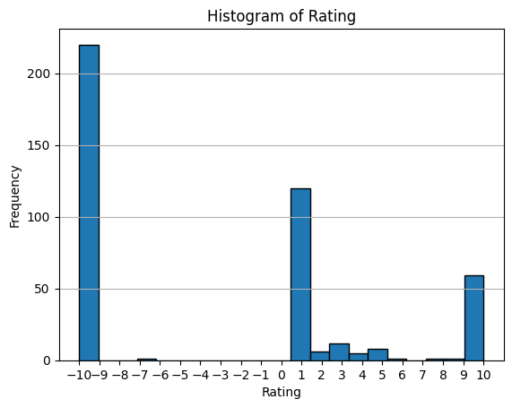
Distribution of Fraudsters’ Ratings
Notes:
Average ratings

Slide 12
Fraud Analysis
Fraudsters
Rating :
3.38
Fraudsters
Combined
Rating :
-3.15
Non
Fraudsters
Rating : -5.41
Notes:
Mode is 1 for all three categories
Nodes with 10 rating are mostly a target, not rating other nodes
The ones that are lowly rated rate others that are lowly rated fairly high.

Slide 13
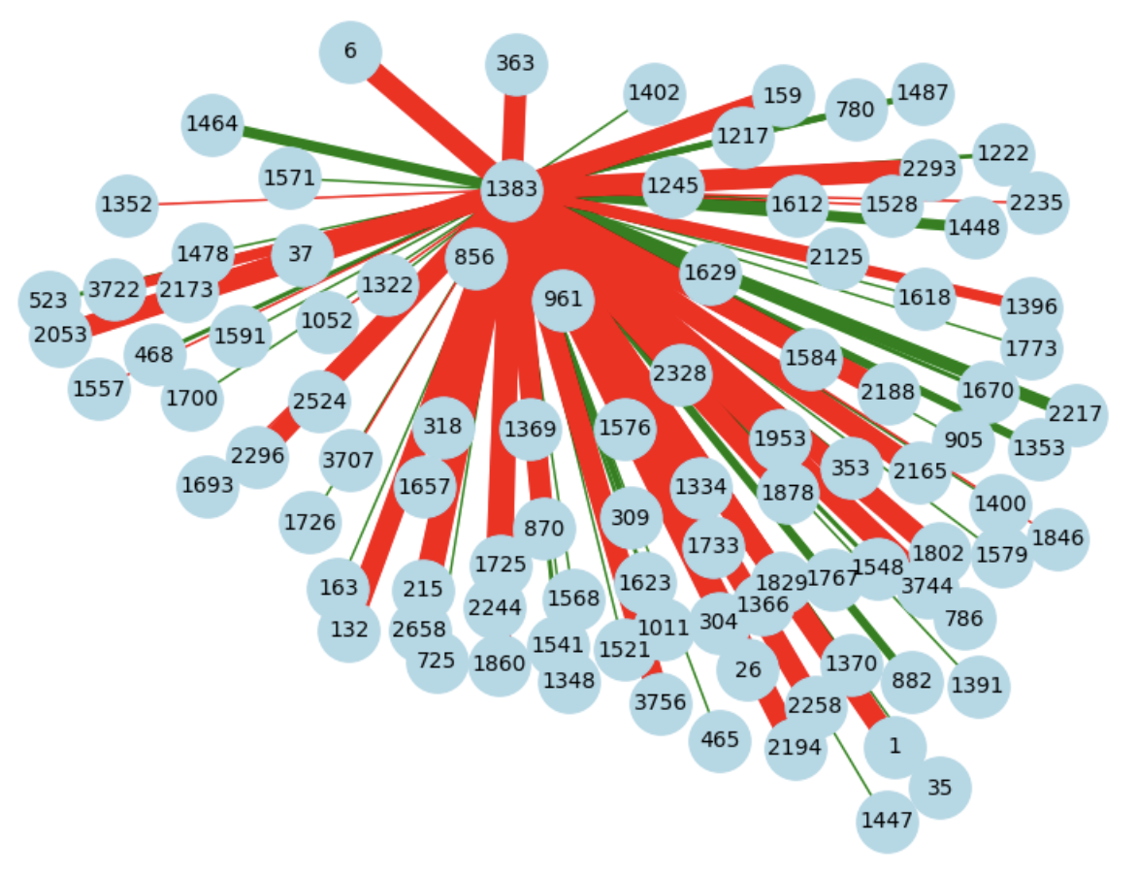
A closer look at Node 1383

Slide 14
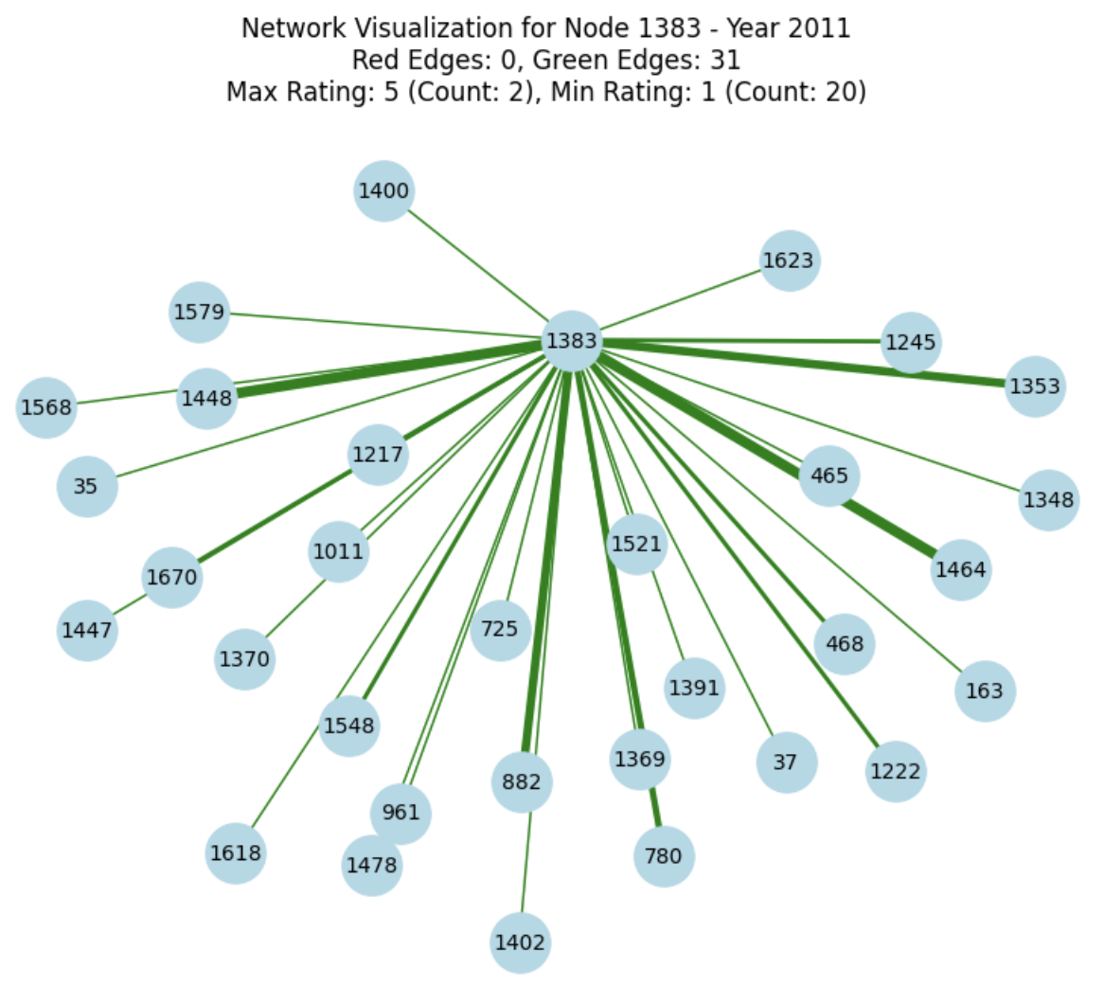
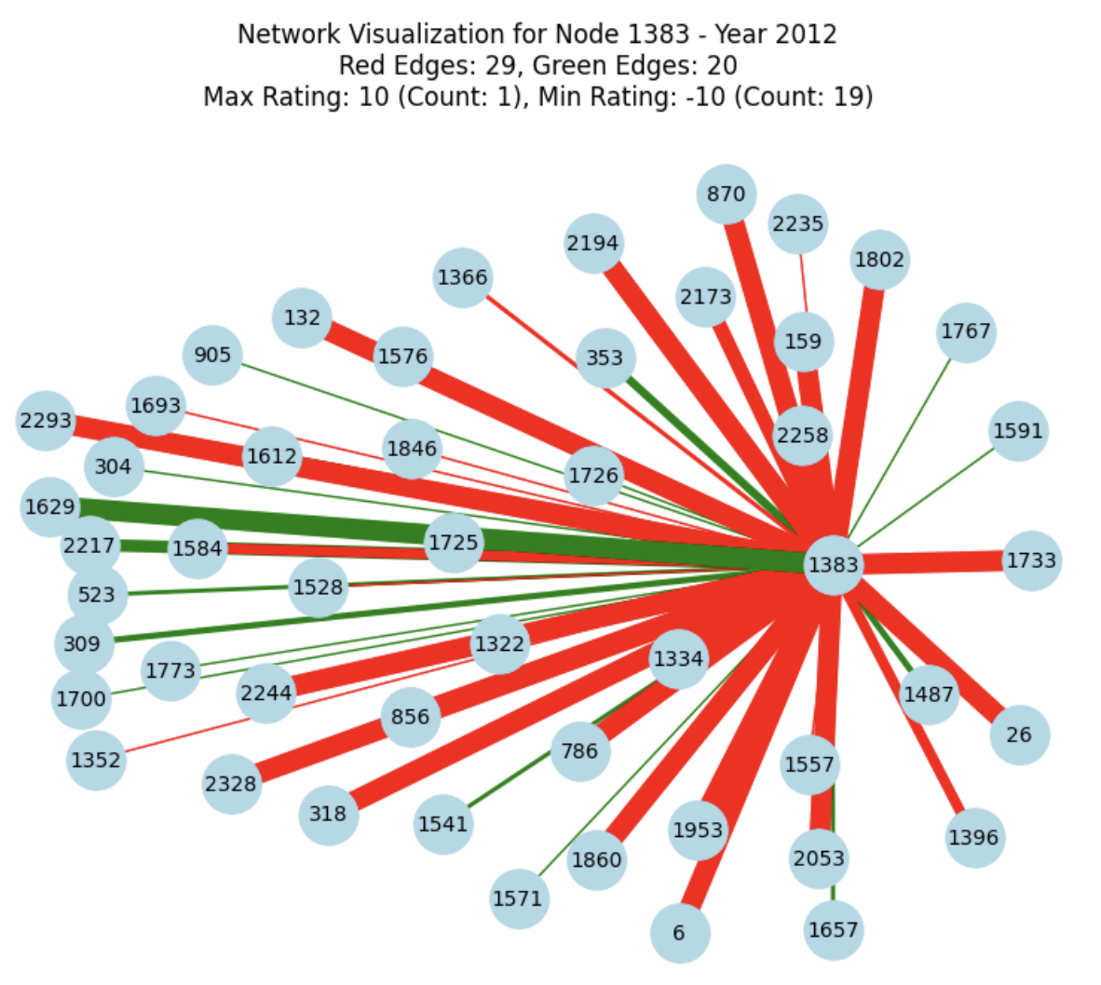
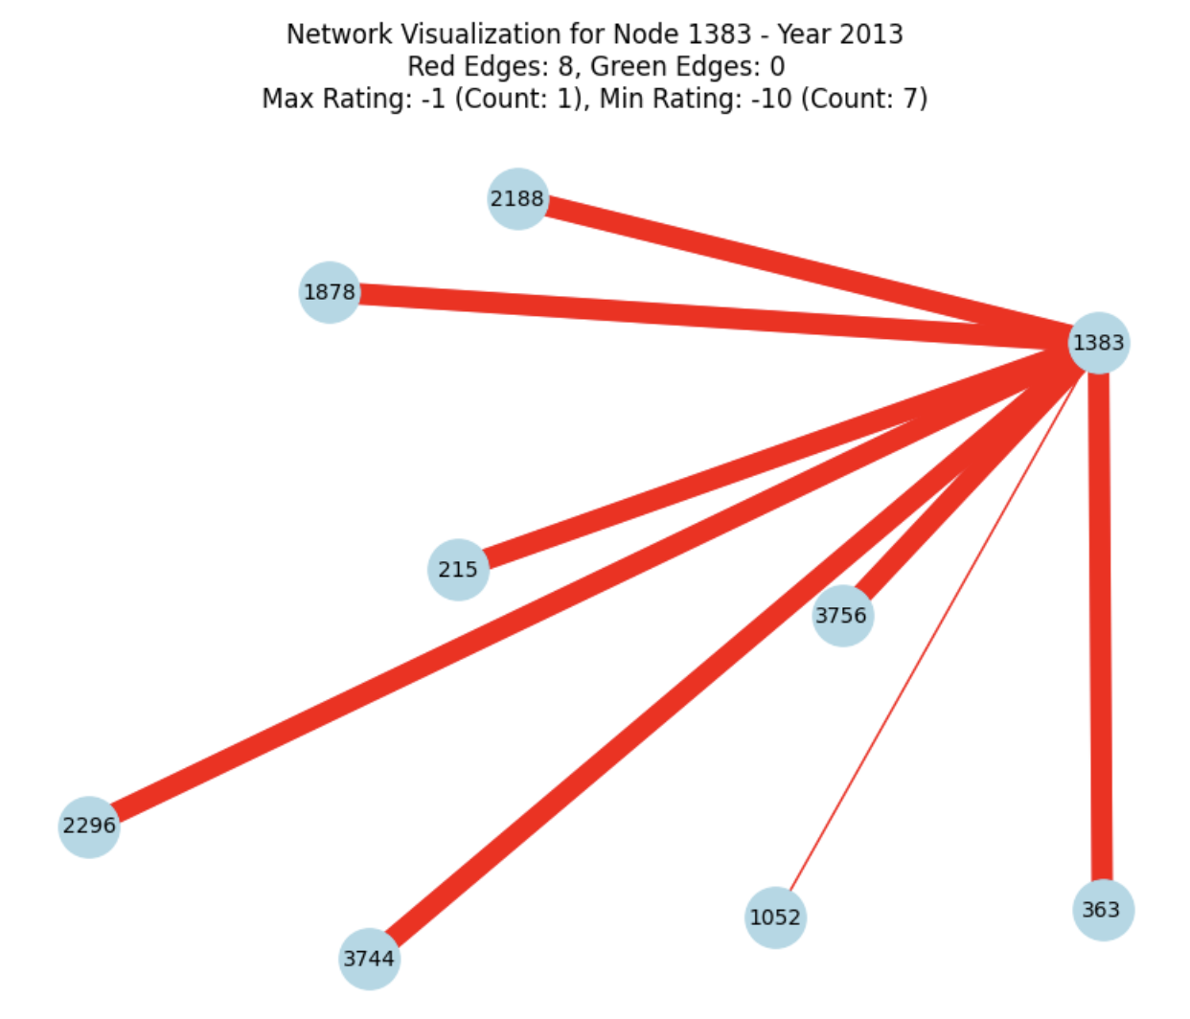
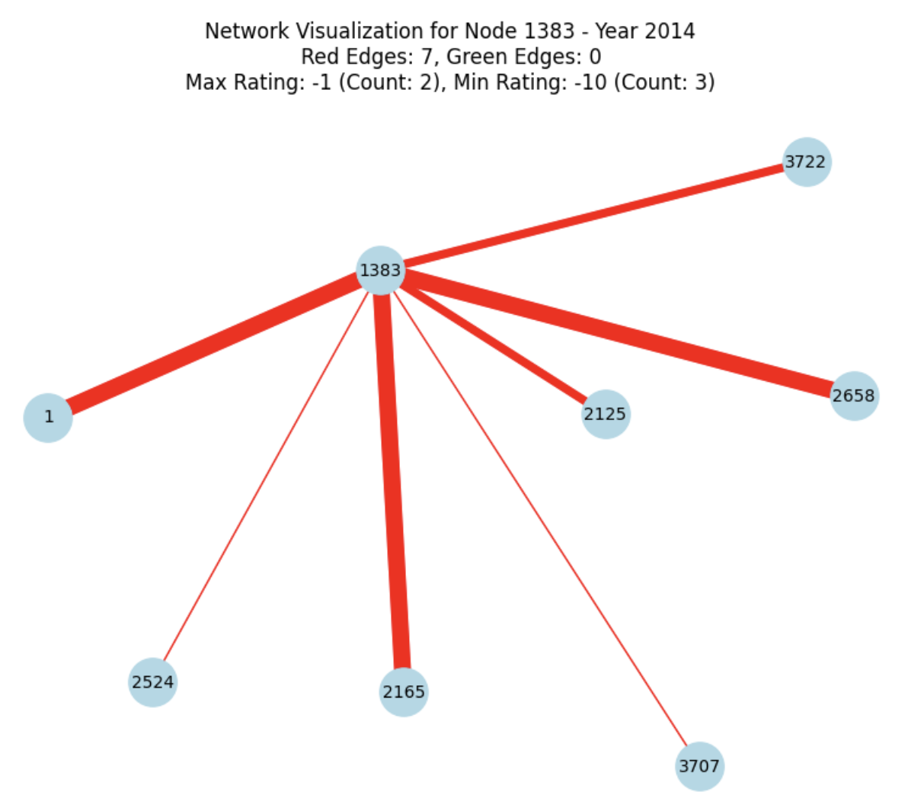
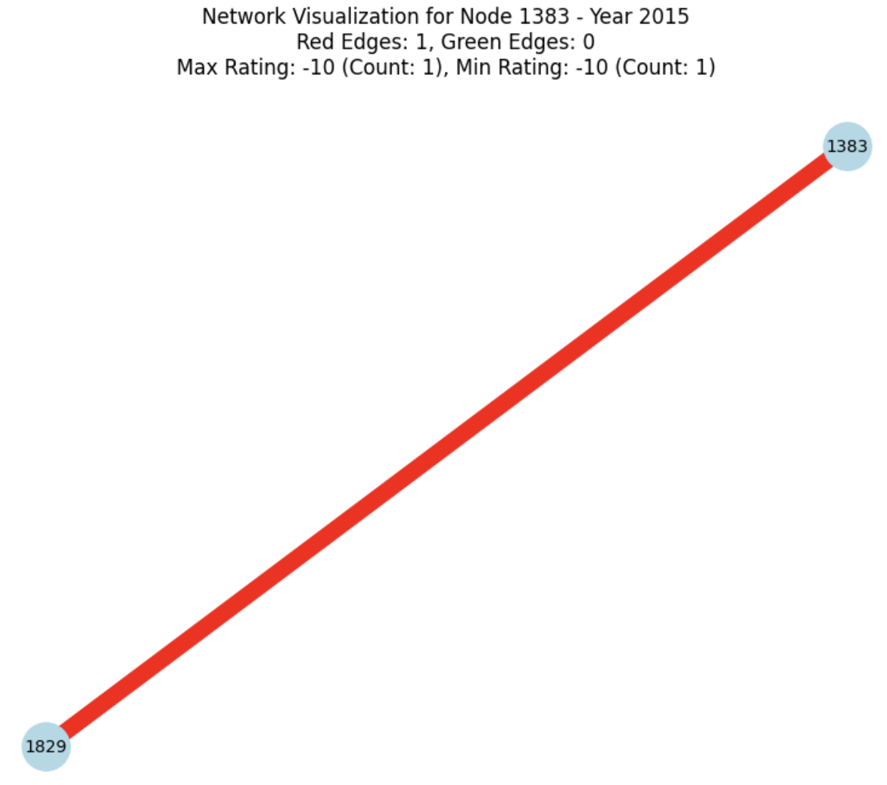
Node 1383 Over Time
Notes:
There are nodes that go from green to red but not the other way around

Slide 15
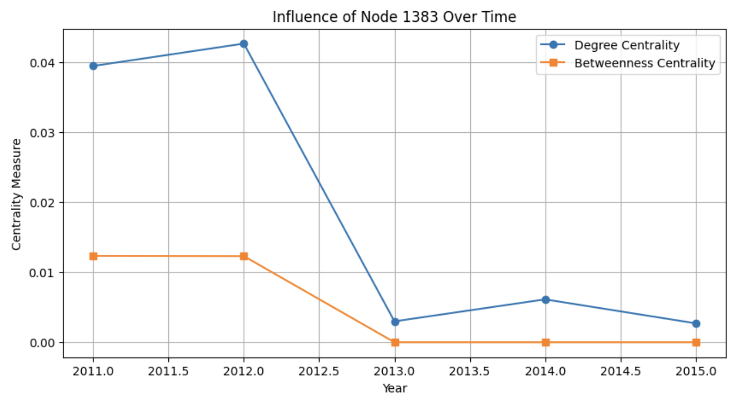
Overall Time Trend

Slide 16
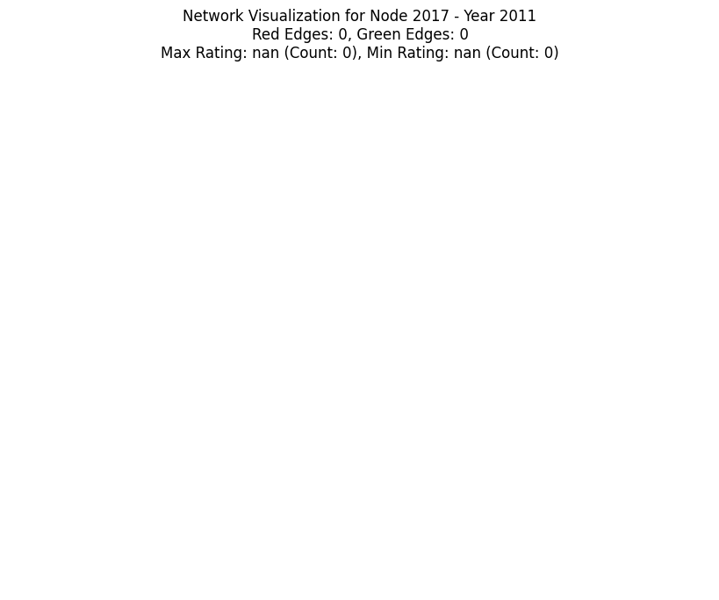
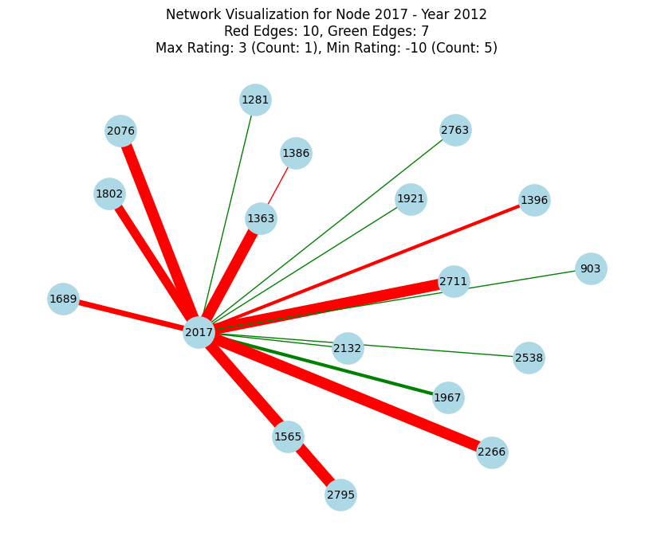
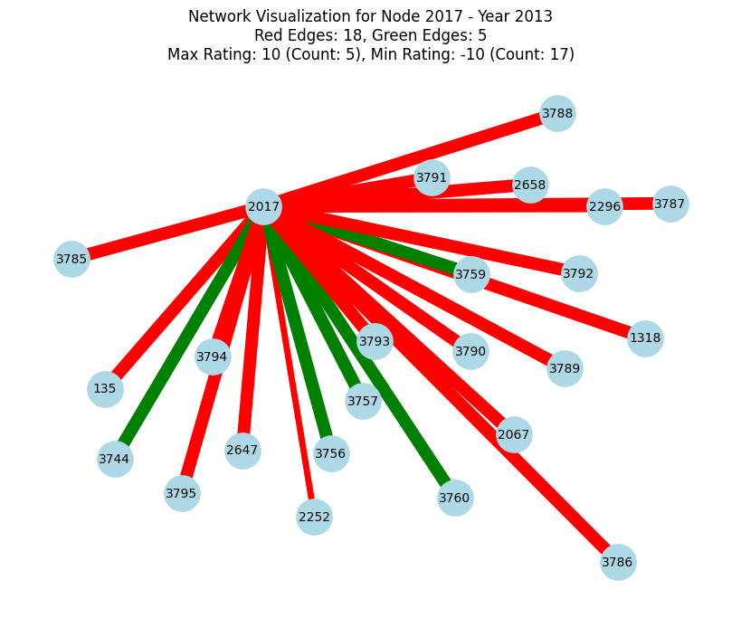
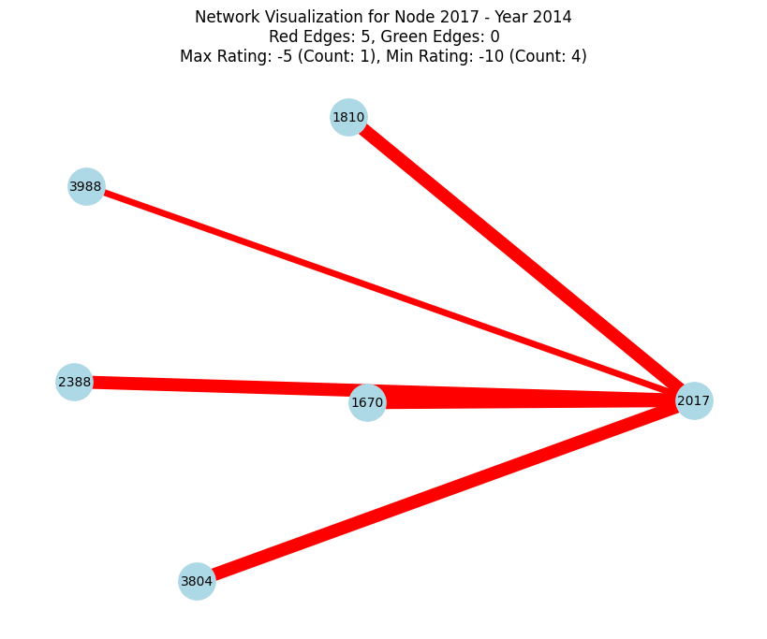
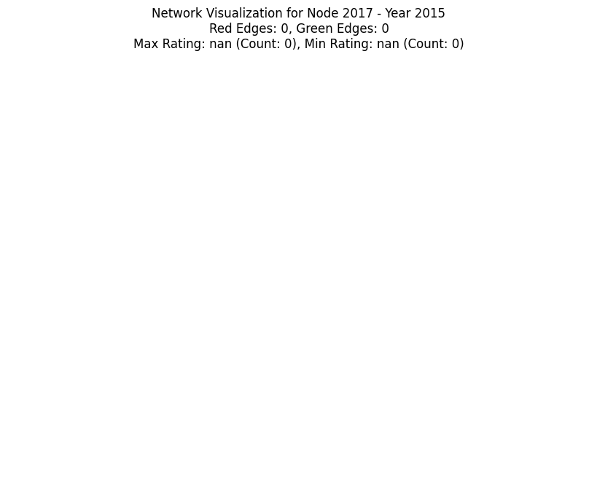
Node 2017 Over Time
Notes:
There are nodes that go from green to red but not the other way around

Slide 17
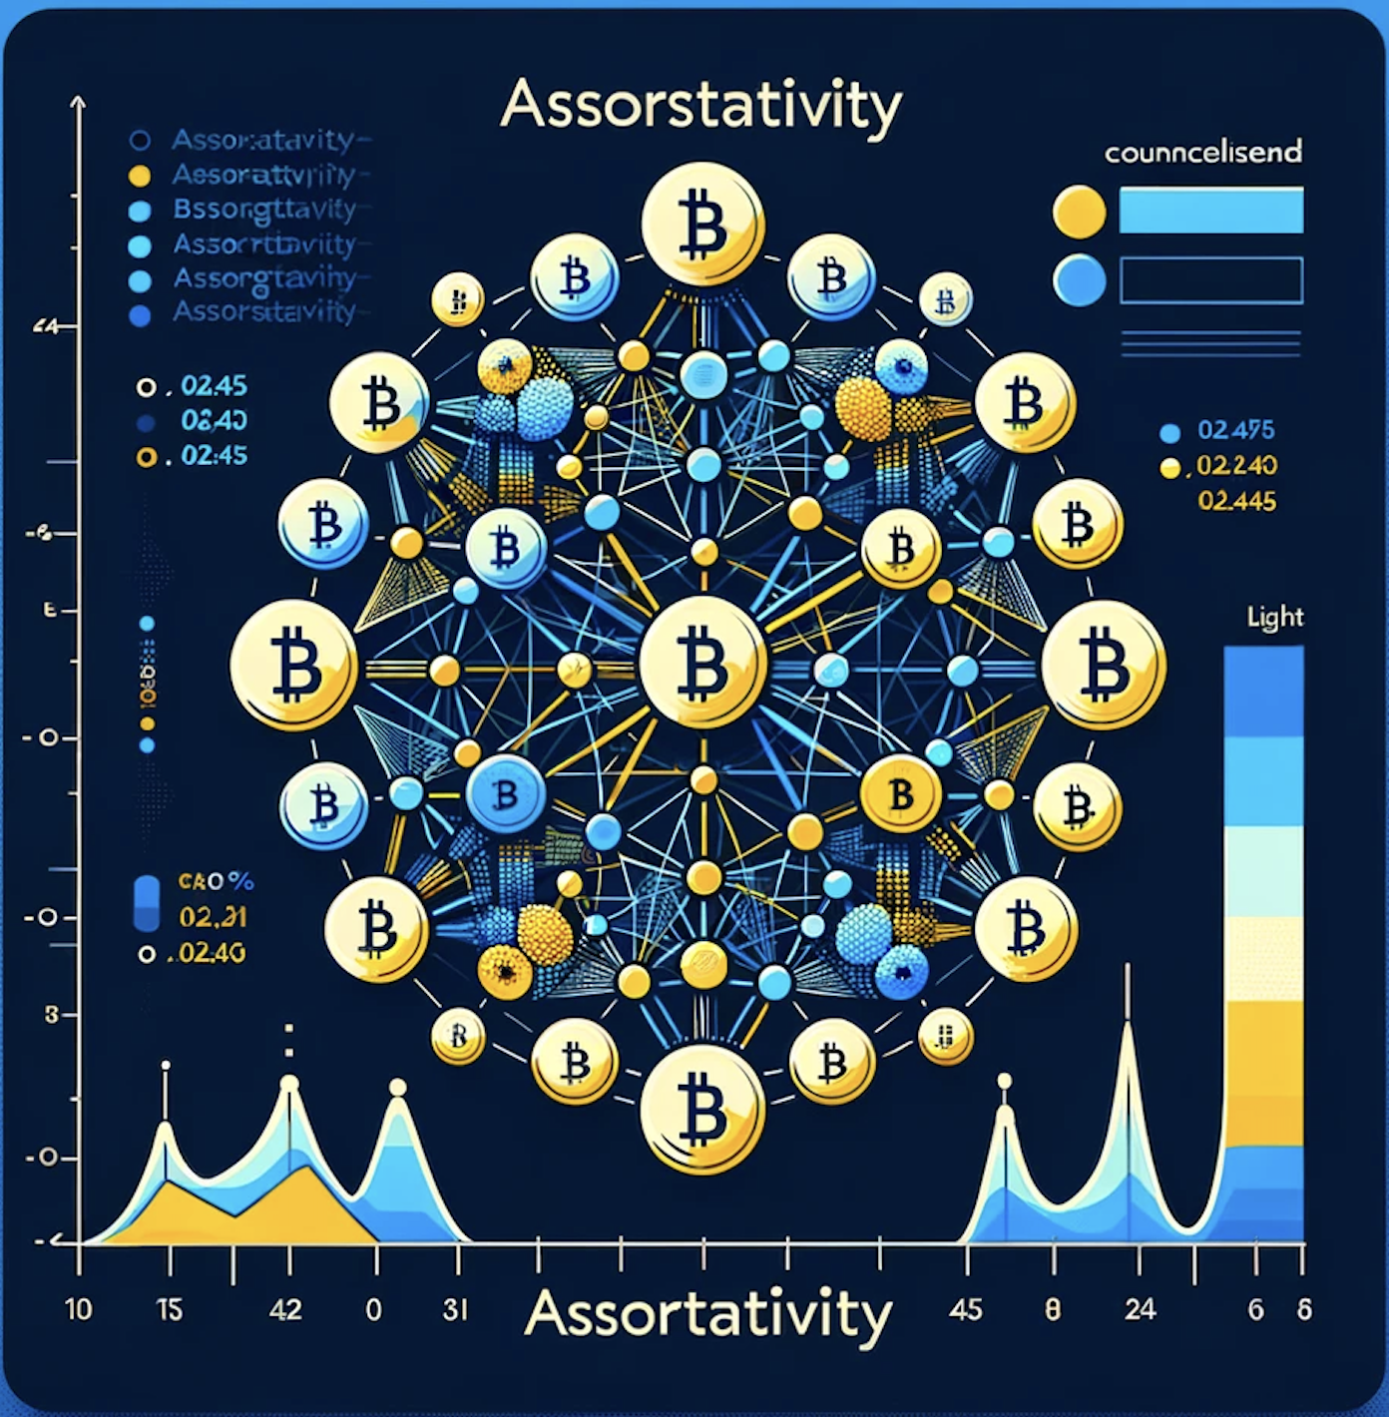
Assortativity
Overall Network Structure
How Nodes Form Connections
Centrality Measures

Slide 18
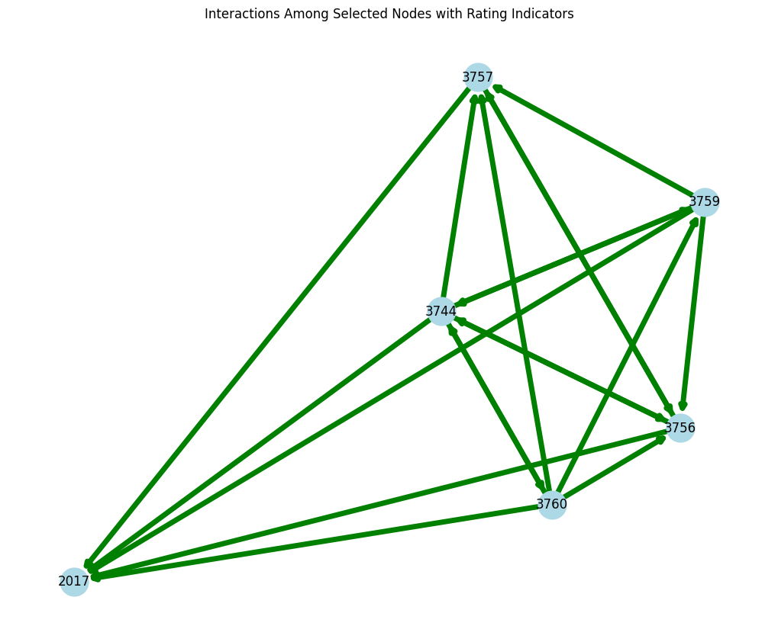
Node 2017 Network

Slide 19
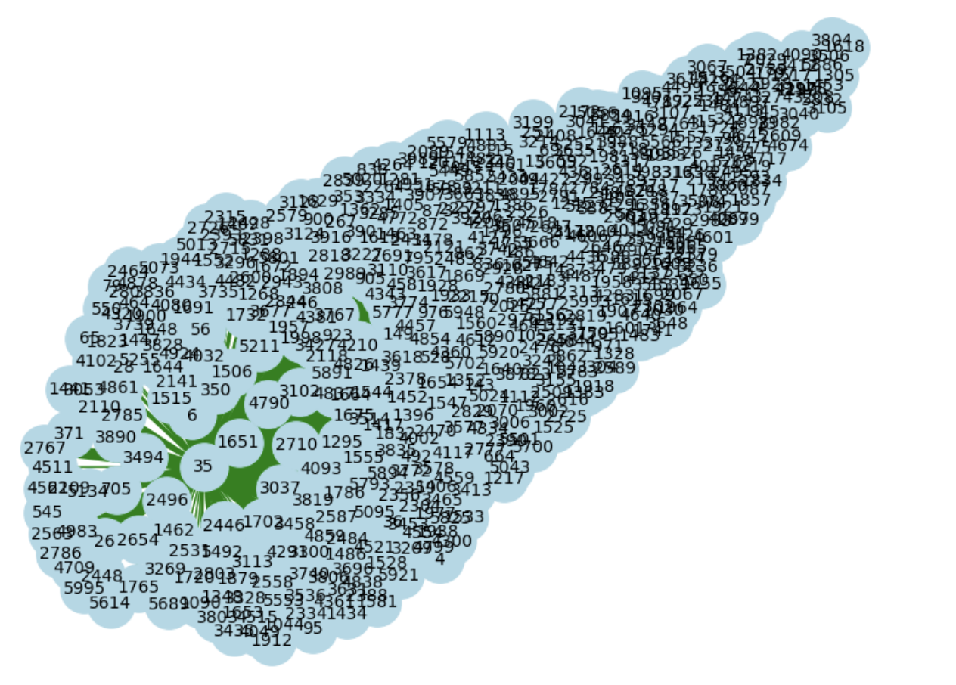
A closer look at Node 35

Slide 20
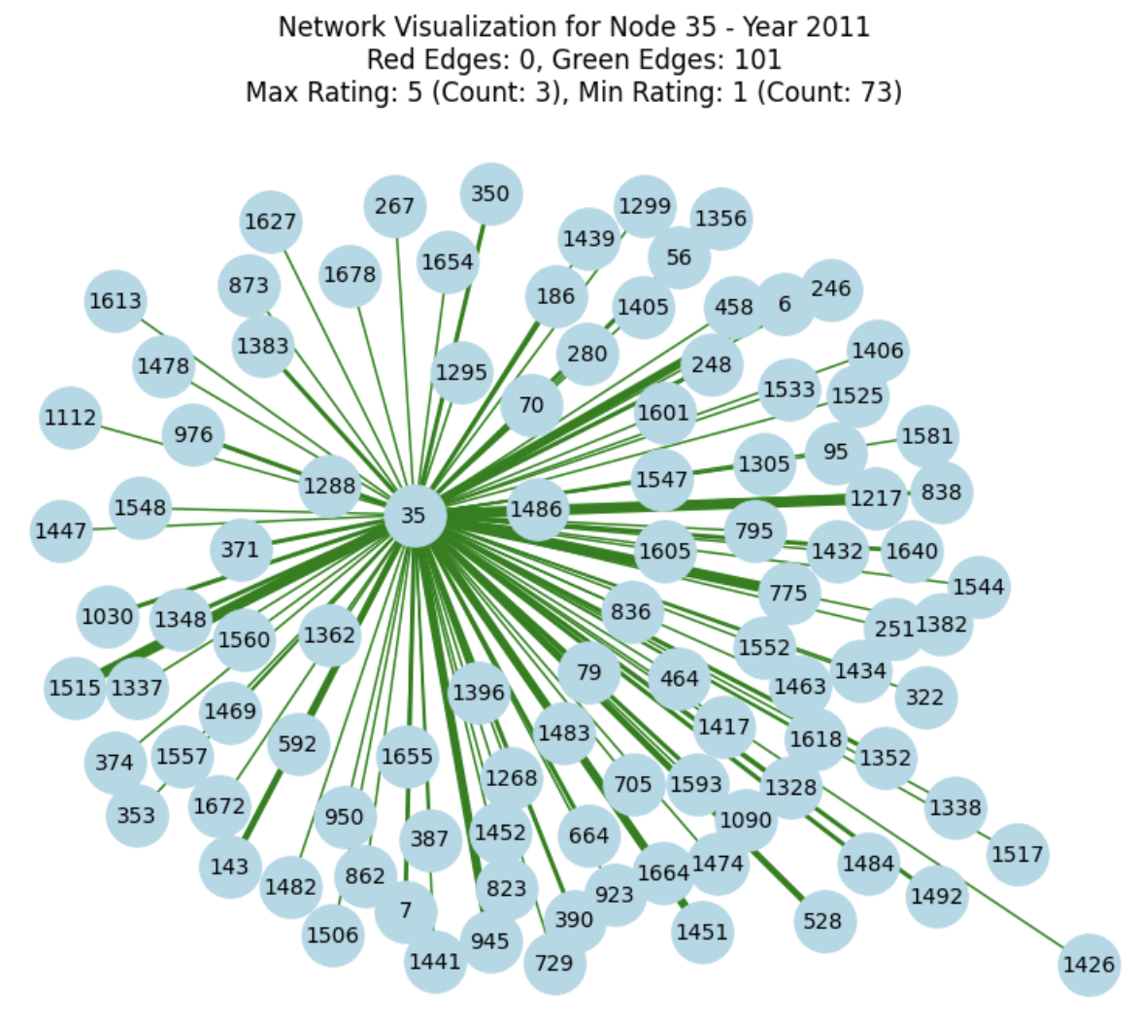
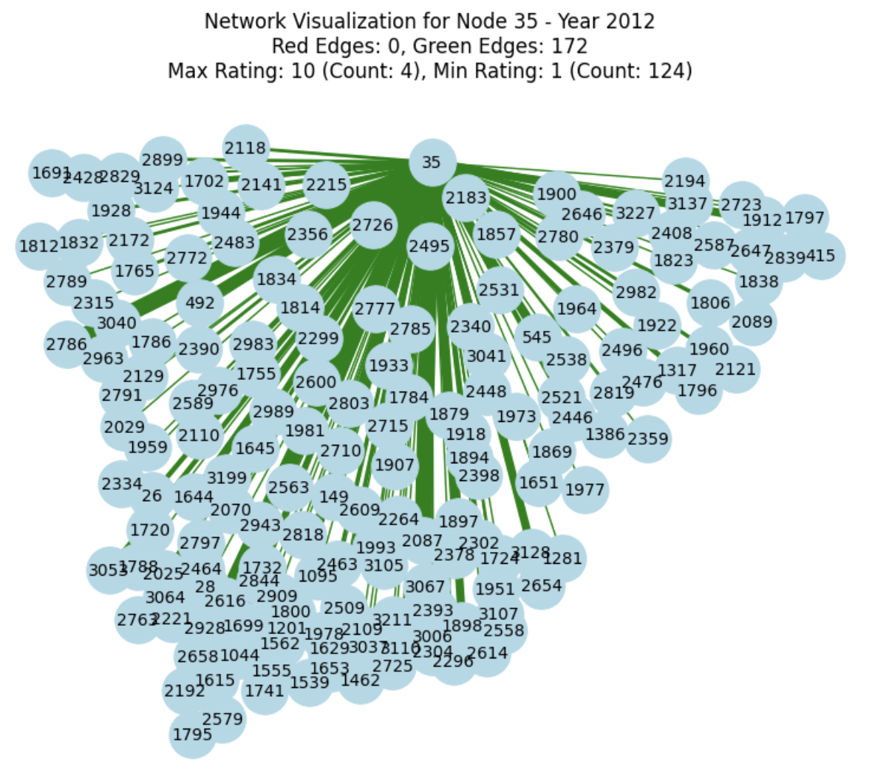
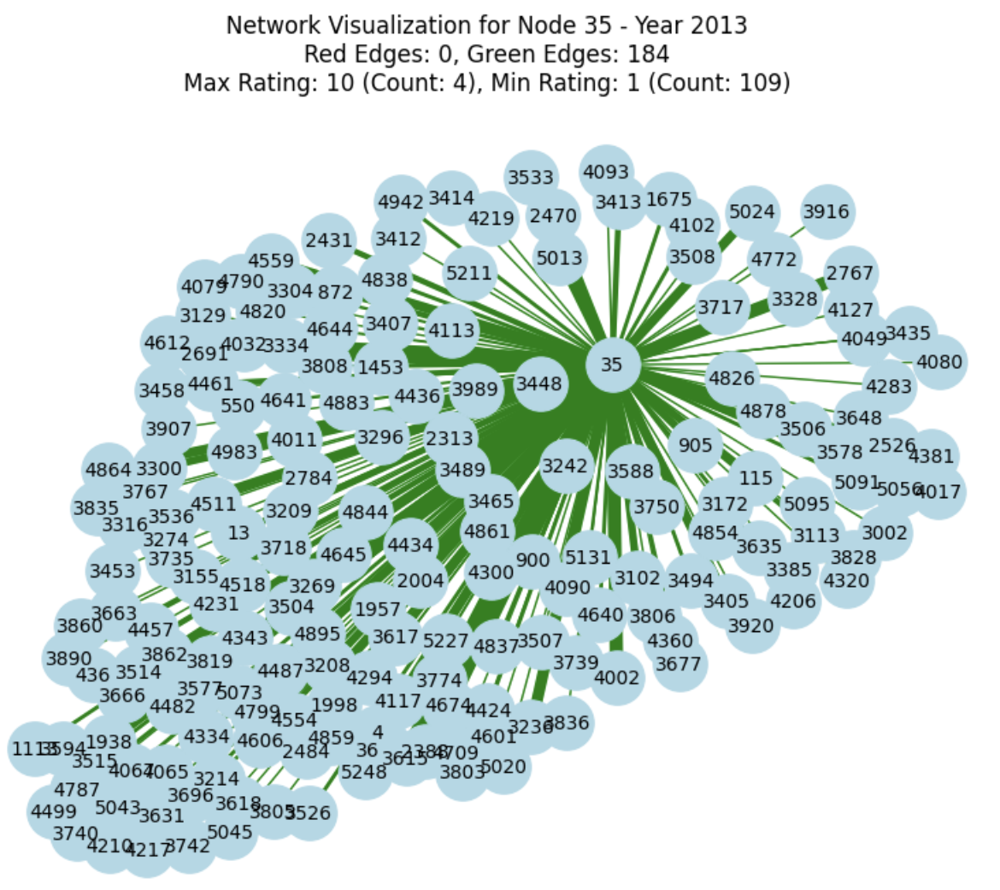
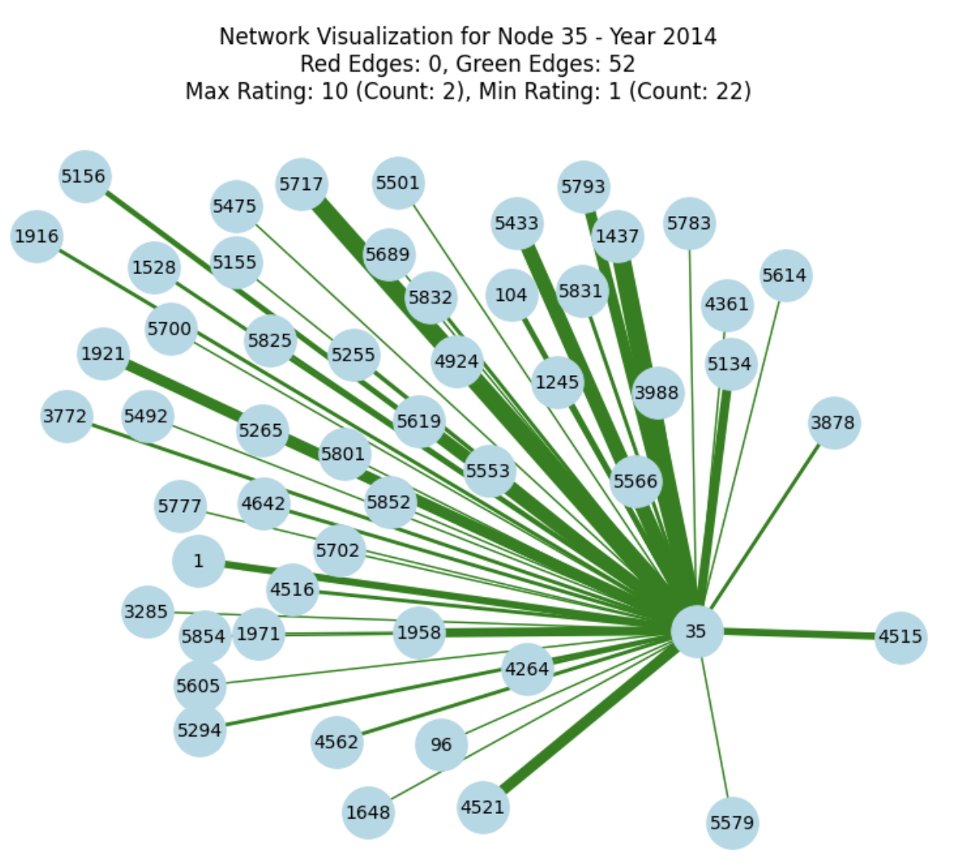
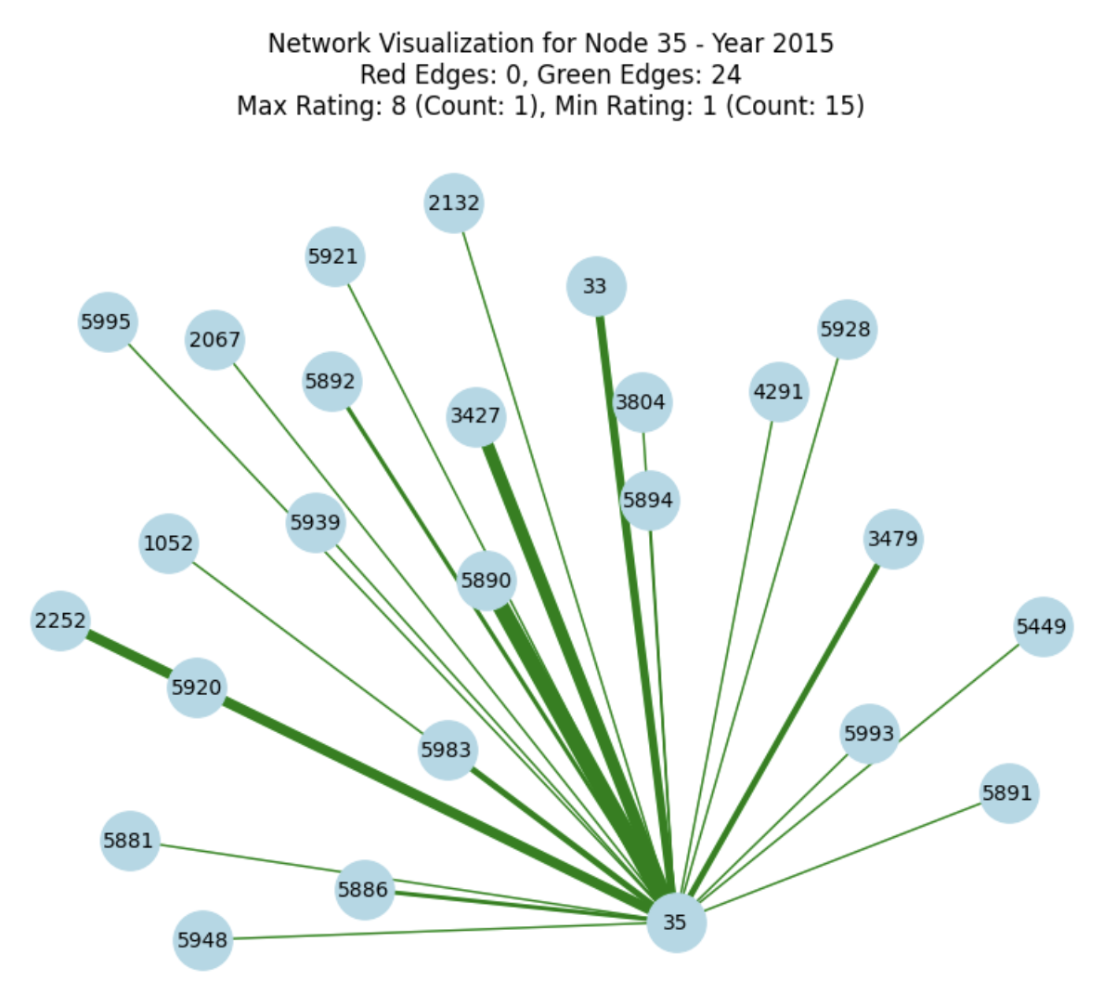
Node 35 Over Time
Notes:
Interaction decreases over time but still no fraudulent node is rating this 10.. Hence this is still legit node

Slide 21
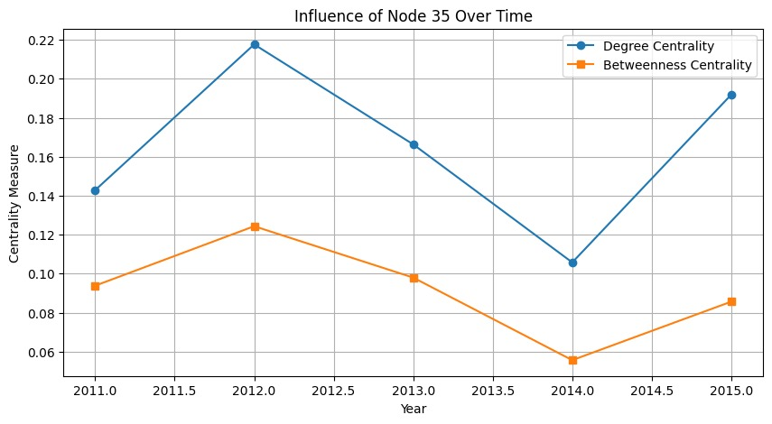
Overall Time Trend

Slide 22
Overall Conclusion
Rating Distributions
Time Trends
Future Impact
Future Work
For each rater category, the average rating is neutral, with a mode rating of 1
An analysis of time trends can assist in identifying dormant or fraudulent nodes at an early stage
Maintain platform integrity by identifying and responding to fraudulent nodes
Employ Assortativity to detect fraudulent networks and promote the genuine ones
Notes:
Future work – detect good nodes(promote) and the bad nodes

Slide 23
Thank You
Do you have any questions?

